Slide 1
Surgical Case
Hospital Infantil de México “Federico Gómez”
Mexico City
Dra. Brenda Domínguez Zúñiga
Dr. Emilio Fernández Portilla
Dr. Roberto Dávila Pérez
Dr. Alfredo Domínguez Muñoz

Slide 2
MEDICAL HISTORY
Female
9 years old
No history of illness in her family

Slide 3
MEDICAL HISTORY
Late diagnosis of anorectal malformation (8 yo)
September 2022 First time at colorrectal center
Physical examination:
Lumbar scoliosis
Anorectal malformation: vestibular fistula
Vaginal agenesis

Slide 4
Physical exam
Urinary incontinence
Incontinence-associated dermatitis
Vaginal agenesis
Anorectal malformation: vestibular fistula

Slide 5
Physical exam

Slide 6
SURGICAL TREATMENT
Colostomy
Meckel’s diverticulum
Absent uterus

Slide 7
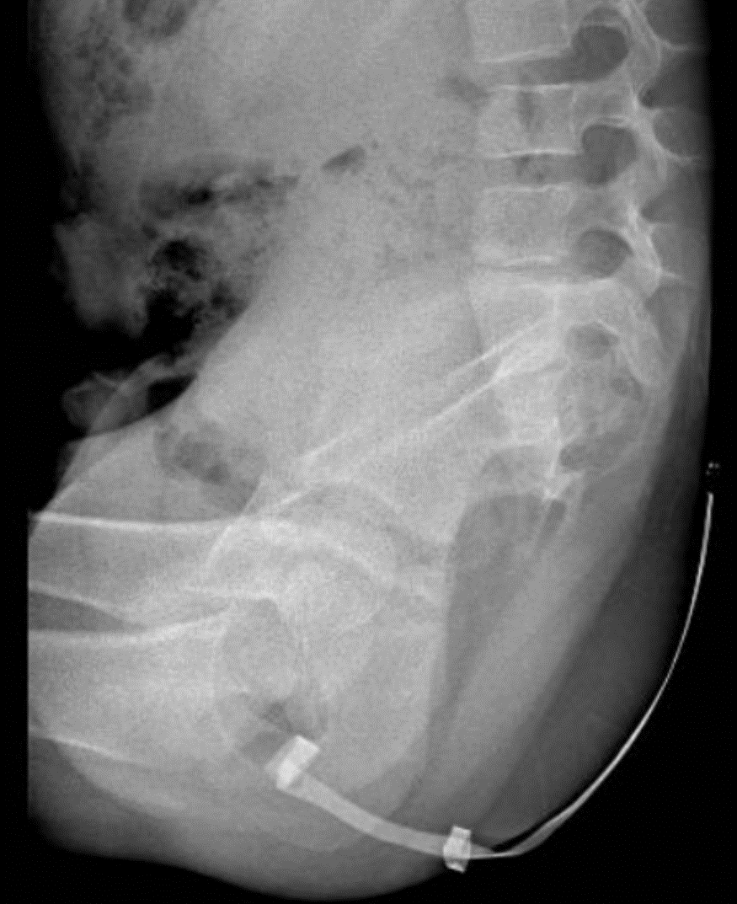
X-RAY FILMS: abnormal sacrum

Slide 8
Sacrum ratio: 0.3

Slide 9
Distal colostogram

Slide 10
Double excretory system (bilateral)

Slide 11
QUESTION 1
What are the chances for bowel control?
Excellent
Poor
I am not sure

Slide 12
QUESTION 2
What is the goal for the vaginal replacement?
A) Sexual function
B) Capacity to procreate
C) I don’t know

Slide 17
TWO MONTHS LATER

Slide 18
THANK YOU

